Slide 1
By Eli Levy, Oze Botach, Azriel Bachrach, Max Friedman, Koby Rosinsky, Asher Kirshtein, Nechama Buchbinder, Yaakov Baker
RegressionLine

Slide 2
Problem: Summarizing SEC Documents is Difficult
A regular SEC document is filed with boilerplate information and paragraphs to avoid legal liability
They also show a very limited chronological range, many items have only a single period
Combing through 100’s of documents is extremely complicated and hard

Slide 3
Solution: RegressionLine
In our application, users can enter a stock ticker and our systems fetch, parse and analyze the data.
Live Pull SEC EDGAR
API For Stock Search
Then it returns a clean interface showing important metrics that include unusual moves

Slide 4
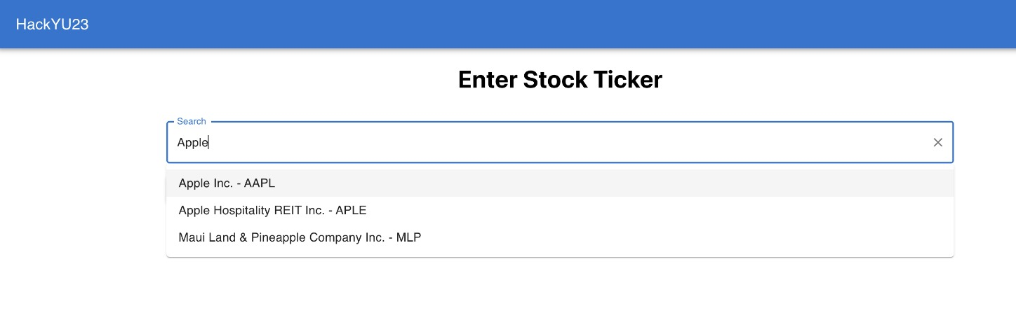
Example: Apple Stock

Slide 5
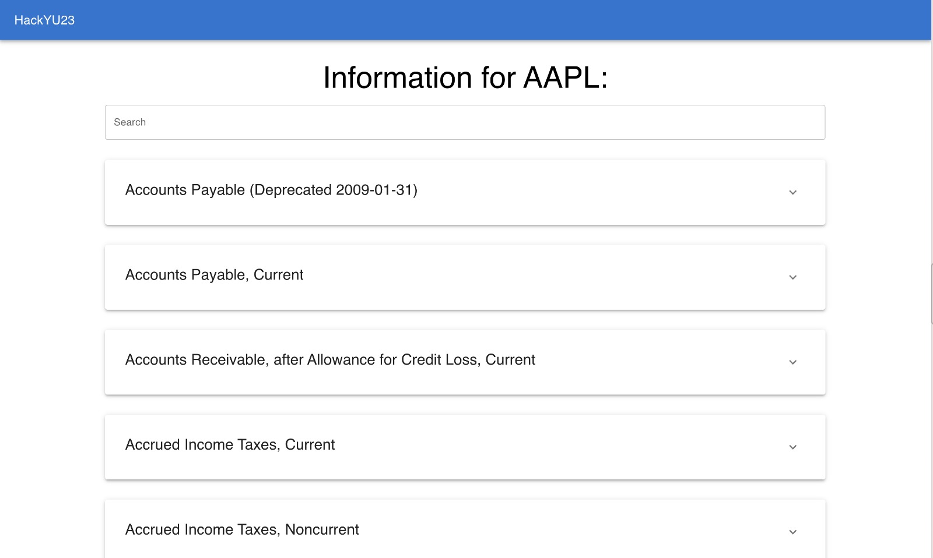

Slide 6
